Slide 1
Social Bread Indonesia Internship
Dylan Adriel Kusumo

Slide 2
Why Internship?

Slide 3
Survival Analysis
A branch of statistics that analyzes the amount of time it takes before a chosen particular event occurs. In most cases, survival analysis is used to predict the amount of time it takes before the death of a person occurs since it was initially developed in biomedical sciences.

Slide 4
Implementing Survival Analysis on TikTok
To implement the analysis on TikTok, the chosen event will be the amount of time it takes before a TikTok Video views stop increasing. To predict this, variables that affect this event needs to be identified. Identifying the variables requires the understanding of TikTok’s algorithm, specifically how it gives views to the TikTok video and recommends them to audiences.

Slide 5
Understanding TikTok’s Algorithm
Categorizes videos using computer vision, NLP, and metadata
Recommends video to audiences suited to the video category
Calculates the engagement factors
Real-time feedback loop from the engagement factor
Recommends more frequently to other audiences with similar category (If engagement factor is good)
TikTok stops recommending if it doesn’t get enough engagement
If User A engages with Video 1, 2, 3, 4 and User B engages with Video 1, 2, 3, 5. Video 5 will be recommended to User A and Video 4 will be recommended to User B.

Slide 6
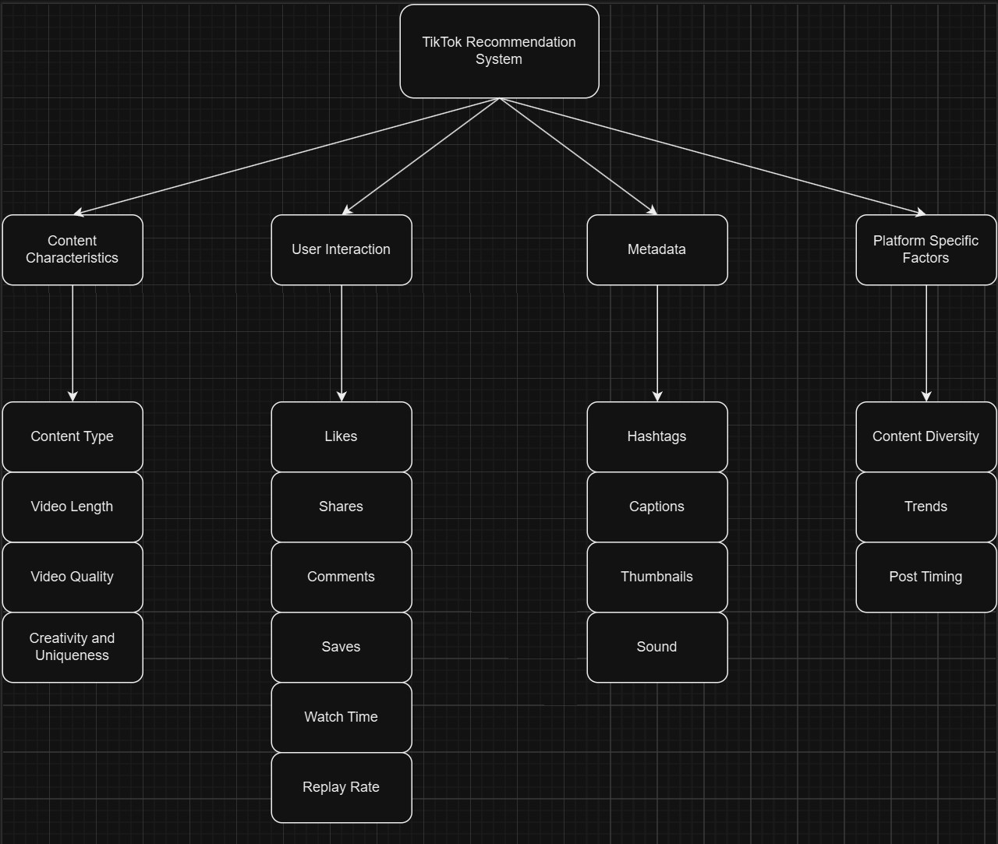
TikTok’s Algorithm Diagram

Slide 7
Algorithm Project Introduction
My algorithm will predict the amount of time it takes before the chosen TikTok Video views stop increasing. We will predict this by identifying the engagement factors that have a good correlation with TikTok views. This algorithm can help content creators strategically schedule new content releases ensuring continuous engagement.

Slide 8
Engagement Factors that affect TikTok Views
I have collected 6 different TikTok video data from their inbuilt analytics tool. These data are from my friends who occasionally post TikTok videos. From the data, I will focus on the key and engagement metrics shown. This include:
Likes
Shares
Saves
Comments
Average Watch Time
Percentage of audience that watched full video

Slide 9
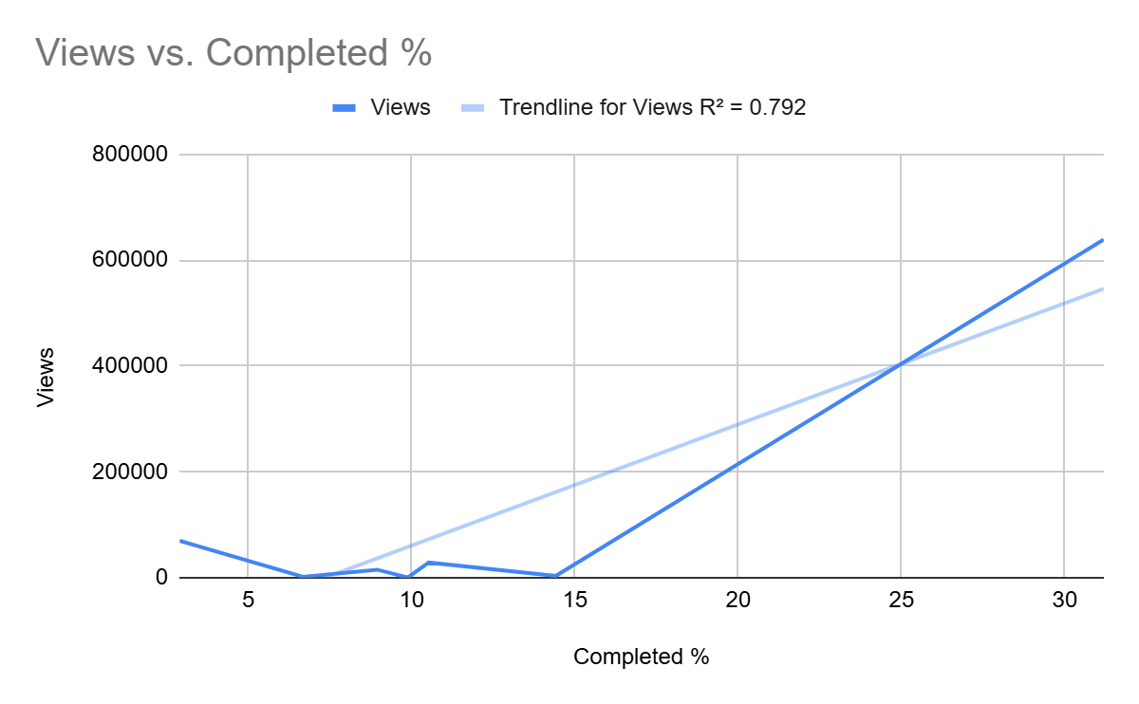
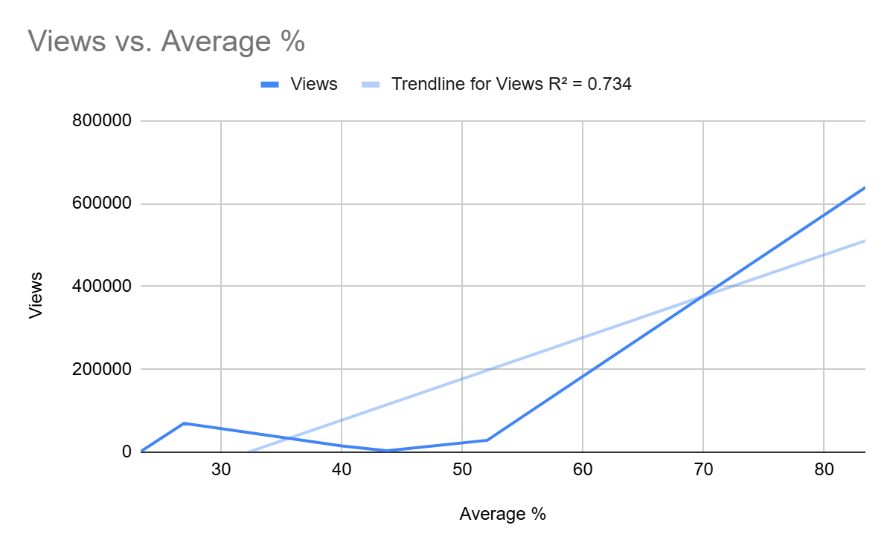
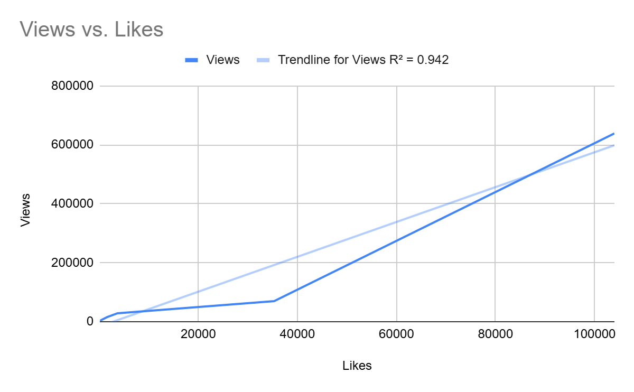
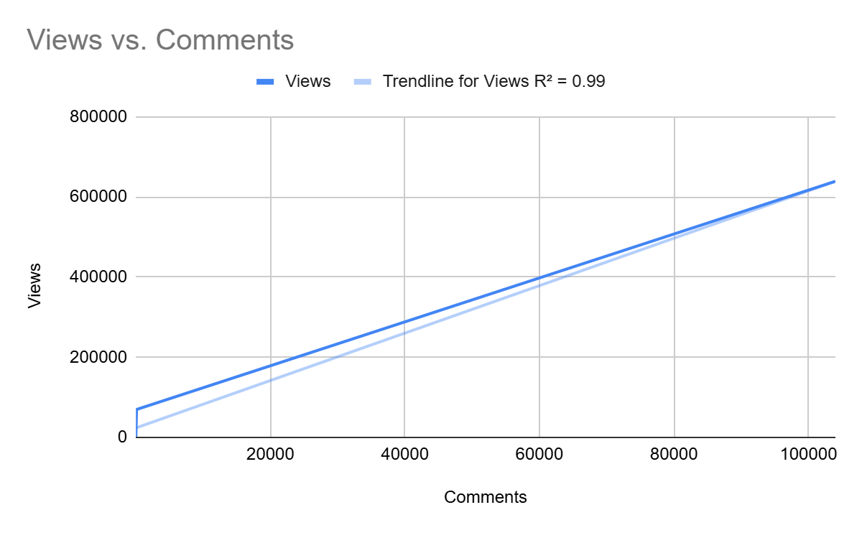
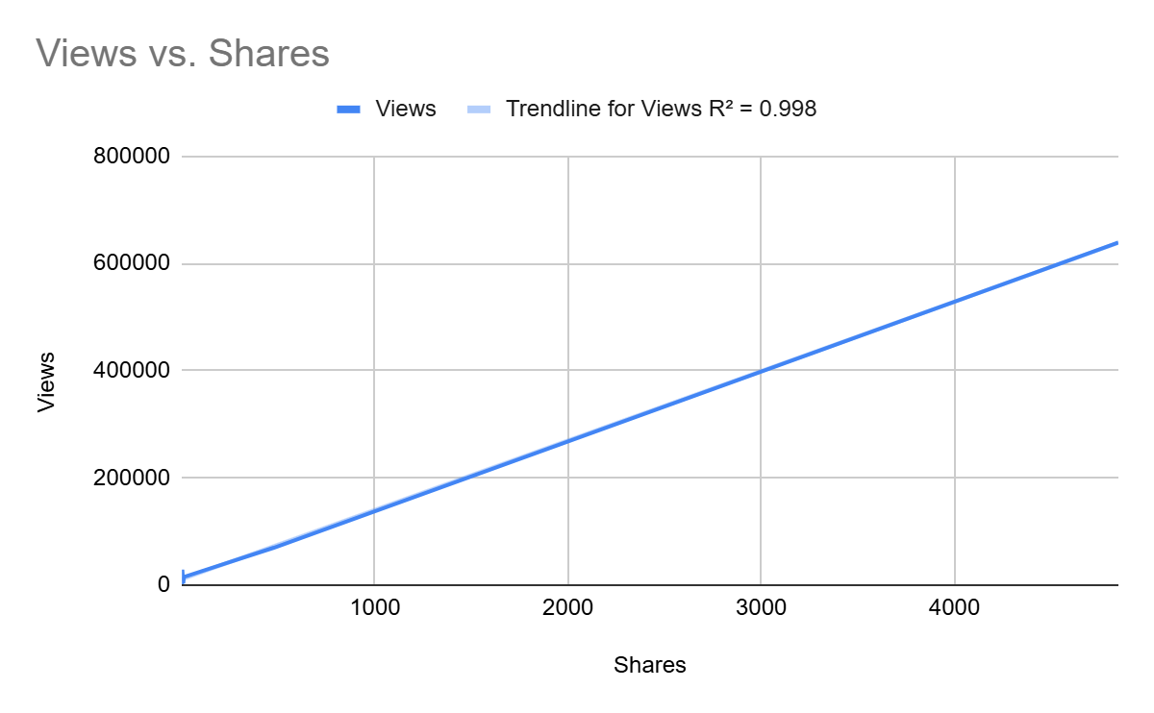
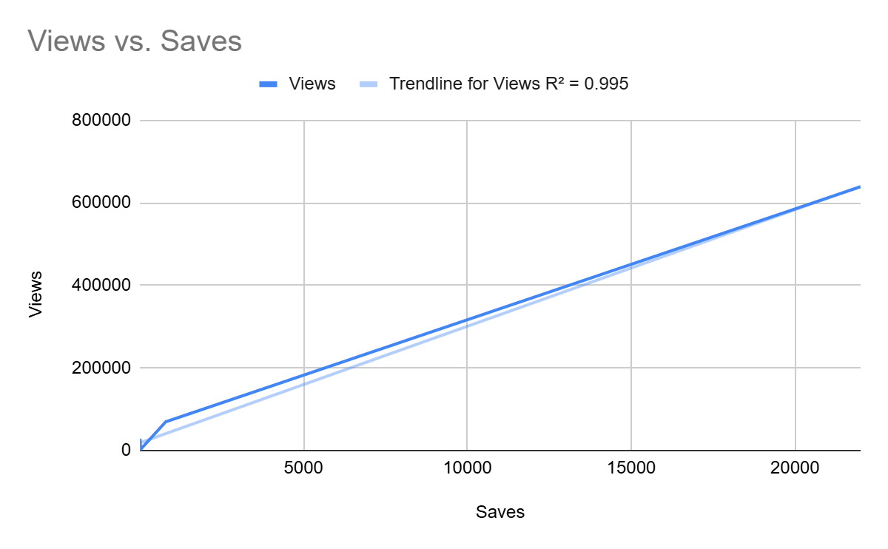
Correlation

Slide 10
Week 2
Collect a lot more key and engagement metrics for a more accurate correlation and justification
Describing the steps of the algorithm
Apply Survival Function, Hazard Function, Hazard Rate, etc (Survival Analysis Concepts)
Apply the algorithm on a TikTok video
Analyze the results from the algorithm
Further improve the algorithm from the results

Slide 11
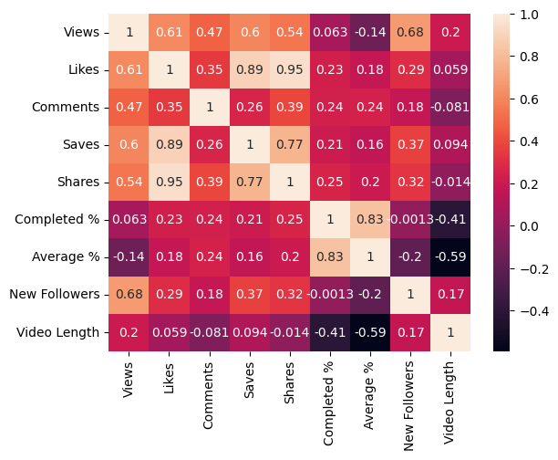
Correlation

Slide 12
Algorithm Steps

Slide 13
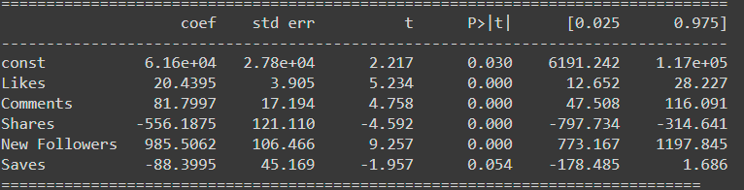
Select the variables
Correlation with views higher than 0.1 (Minimal signs of correlation).
The input variables would be Likes, Saves, Shares, Comments and Followers gained. The output variables is Views.
This can also be supported by calculating the p value. The p value shows the probability of having this level of correlation between these variables and the views by random chance. A small p-value would usually be considered 0.05 or under. For the variable saves, it is slightly above 0.05 which is considered acceptable.

Slide 14
2. Apply Multiple Linear Regression
Since we don’t have the data on the amount of time it takes for the tiktok views to stop increasing, we will use MLR to predict the views first.
Split the data into 70% for training and 30% for testing.
Scale the training data for input variables preventing outliers to affect the prediction.
Apply logarithmic transformation to the output variables train and test data to minimize skewed distribution and multiplicative relationships
We use the scaled train input data and the logarithmic train output data to the linear regression model finding the best linear relationship
After finding the best linear relationship, we use the testing input variables to predict the testing output variables. We also use the linear relationship to predict the whole data.

Slide 15
3. Scaling the prediction into the amount of time
After predicting the views for all the data, we will use the predicted amount of views to predict the amount of time it takes for Tiktok views to stop increasing in that amount. After doing research, we will use this linear scale:
10,000 views - 3 days, If <=10k Equation = pred views / 10k * 3
100,000 views - 10 days, If <= 100k Equation = 3 + (pred views - 10k) / 90k * 7
1,000,000 views - 30 days, If <= 1000k Equation = 10 + (pred views - 100k) / 900k * 20
Beyond 1,000,000 views - If > 1000k Equation = 30 + (views - 1000k) / 9000k * 30

Slide 16
4. Acquiring the date
Since we have got the amount of time it takes for the TikTok views to stop increasing, we can add that time to when the TikTok was released. From there, you will get the date of when the TikTok views will stop increasing.

Slide 17
Possible Improvements on the algorithm
Clear criteria on when to use logarithmic transformation and standard scaler
Try other splitting ratios of the data
Use of random state
A quadratic scale instead of linear
Use of input variables when scaling since it is a predefined scale as the number of views doesn’t mean the same time it takes to reach that
Correlation between number of views and time it takes to stop at that views
Use of other models than Linear Regression

Slide 18
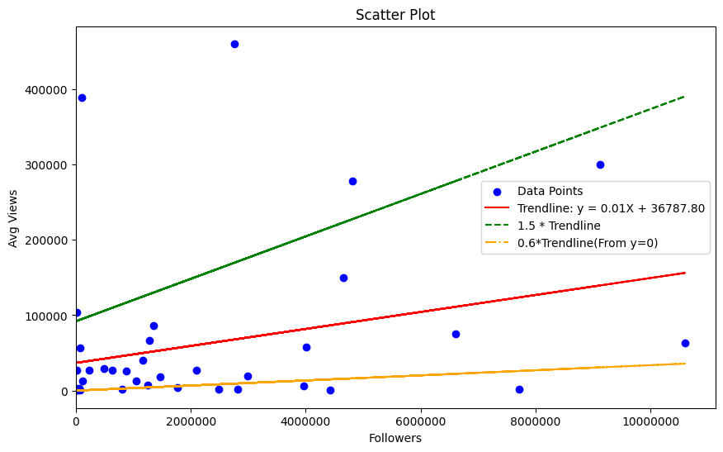
How followers can affect average views

Slide 19
Thank You

